Slide 1



FZ A-TRACKER
PROJECT PROPOSAL
Presentors:
Zirk Ji E. Abelgas
Febb Vendick Layson

Slide 2




Table Of Contents
Problem Statement
Flow of code(flowchart)
Planned inputs
Project objectives
Sample output
GitHub repository link
Planned features
Flow of code(pseudocode)
Conclusion

Slide 3



Problem Statement
Students often struggle to track grades and study progress in an organized way. FZ A-Tracker solves this by storing scores, identifying performance patterns, predicting future results, and sending study reminders, making academic monitoring simpler and more efficient for students.

Slide 4
Project objectives
  To design a basic program that allows students to record and monitor their scores and grades accurately.
  To include a simple feature that shows general performance trends based on previous results.
  To add a notification system that reminds students about study times or important tasks.
  To provide an option for users to save or export their grade records for future reference.
  To create an easy-to-use academic tracking tool that both students and teachers can navigate without difficulty.

Slide 5
Planned features
  Grade Input & Management – Enter, edit, and view student scores
2.Performance Trend Overview – View simple charts or summaries of performance
3.Study Reminder System – Receive reminders for study sessions and tasks
4.Export & Save Records – Download or save grade records as PDF or CSV
5.User-Friendly Interface – Easy-to-use design for students and teacher

Slide 6





Student Information
Name, ID, Class/Grade
Optional: Age, Gender, Learning Preferences (for personalized recommendations)
Subject name
Scores/grades per test (e.g., 12/20, A, 75%)
Test date
Academic Performance
Planned inputs
Test type (quiz, midterm, final)
Weightage of the test (if applicable)
Test Metadata

Slide 7
Individual Scores Analysis
Display scores per subject and per test
Visual representation: charts/graphs showing trends over time
Predictions & Insights
Predicted next score based on past performance (using average, weighted scores, or AI model)
Highlight strong and weak subjects
Study Recommendations
Personalized reminders for revision based on weak areas
Suggested study materials or resources
Study schedule or micro-goals
Sample outputs
Reports & Exports
Export grades as CSV, Excel, or PDF
Optional: Generate performance reports with trends and predictions
Progress Tracking
Show improvement over time
Compare performance across multiple attempts/tests

Slide 8
Flow of code (Pseudocode)
Start
Ask for student name
Initialize empty list of scores
While user wants to add score:
Input score
Validate input
Store score
Calculate prediction (e.g., average of scores)
Display all scores
Display predicted score
Option to export scores
Option to set study reminder
End

Slide 9
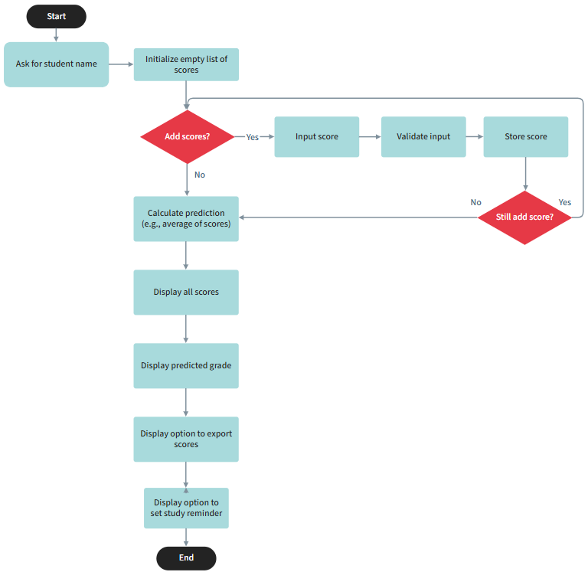
Flow of code (Flowchart)

Slide 10
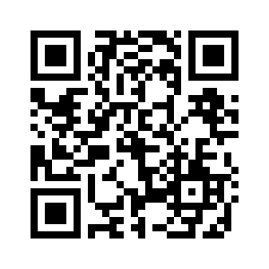
GitHub repository link
[https://github.com/zj45679/Layson-Abelgas]

Slide 11
Conclusion
In the end, FZ A-Tracker is all about making a student’s academic life easier. By keeping grades organized, showing trends, and offering helpful reminders, it gives students a clearer picture of progress. Our goal is simple, help learners stay on track, improve steadily, and make studying a little less stressful.

Slide 12

THANK YOU

